Slide 1

Chapter 12: Wave properties
Bishop Stopford School
faith | justice | responsibility | truth | compassion
All work to be done in your exercise book. If you run out of space, start another book.
Print out all worksheets. If you don’t have a printer, write answers in your book using FULL sentences.
ONLINE LEARNING
Print off specification sheet from:
https://bishopstopford.fireflycloud.net/science-2/school-closure-tasks/year-10-1/physics/triple-1/p12-wave-properties

Slide 2
P12 Lesson 6: Seismic waves
Week 4 (11th May to 17th May)
Year 10
Triple physics

Slide 3
Learning objectives
Describe what seismic waves are and the different types.
Explain how seismic waves let us learn about the Earth’s structure.

Slide 4
Retrieval
What are the 4 layers of the earth called?
Write any additional information you know about each layer.

Slide 5
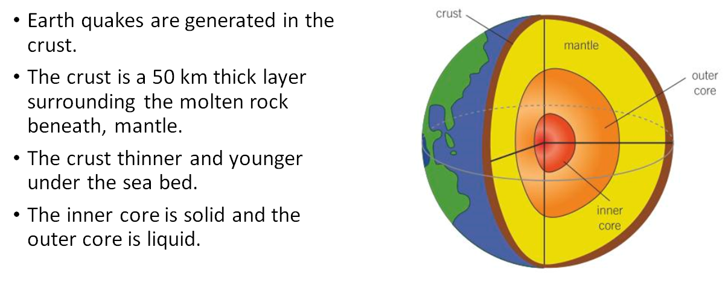
Retrieval: possible answer

Slide 6
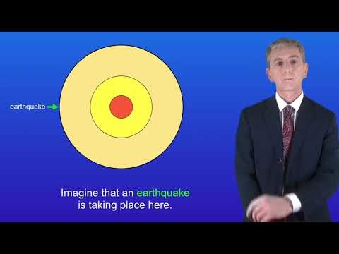
Acquire – watch the video
Make notes.
Pause or re-watch the video if necessary

Slide 7
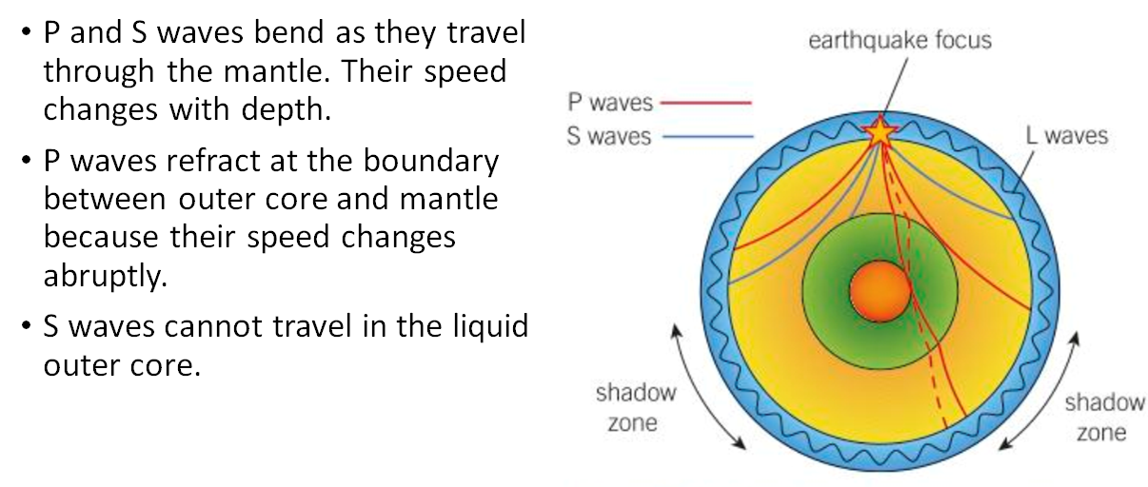
Acquire – learning about the Earth’s structure
P waves are longitudinal
S waves are transverse

Slide 8
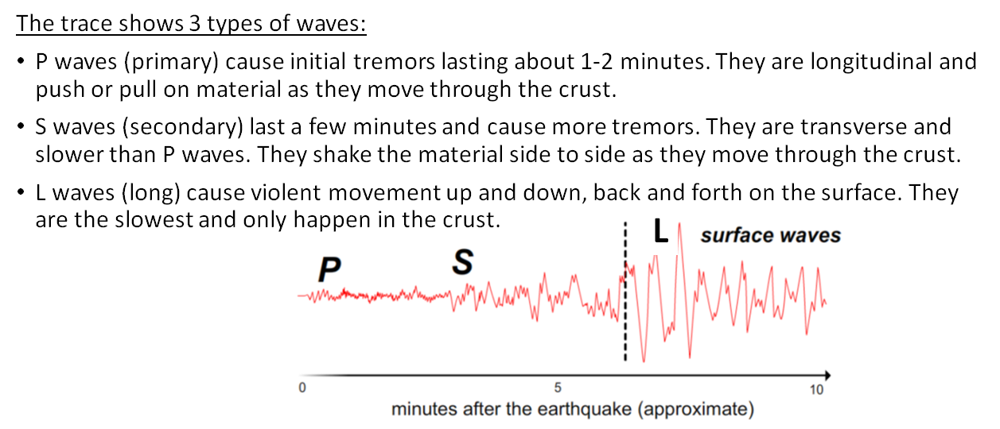
Acquire – seismometer trace
A seismometer is a device used to detect earthquakes. It produces a trace showing the 3 possible types of waves

Slide 9
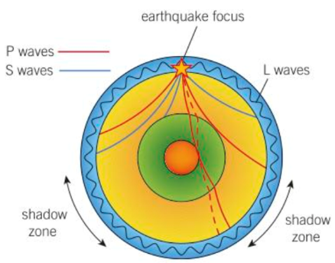
Acquire – shadow zones
1. P waves refract at the boundary between mantle and outer core, then refract again when they leave the outer core. The second refraction is further around and cannot reach the shadow zone.
2. S waves are transverse and cannot travel through a liquid outer core.

Slide 10
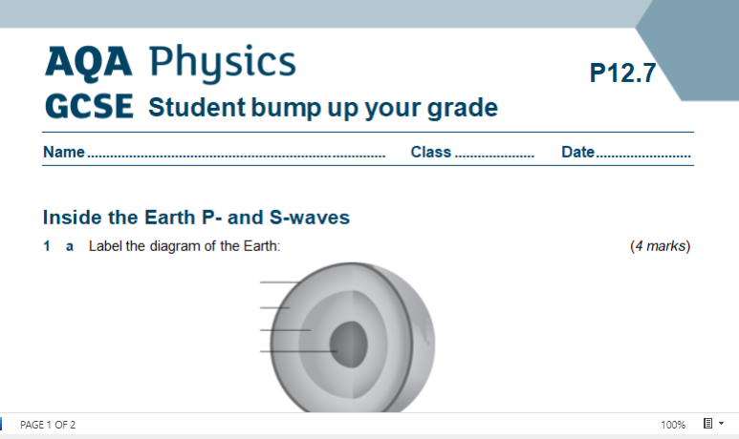
Action – worksheet
Access and print 2 pages per side from:
https://bishopstopford.fireflycloud.net/science-2/school-closure-tasks/year-10-1/physics/triple-1/p12-wave-properties
If you don’t have a printer, write full sentences in your book.

Slide 11
Review
What are the 2 main types of seismic wave?
What can P waves travel through?
What can S waves travel through?
What is a shadow zone?
Why do we detect P waves first on a seismometer trace?

Slide 12
Review – can you….
Describe what seismic waves are and the different types?
Explain how seismic waves let us learn about the Earth’s structure?

Slide 13
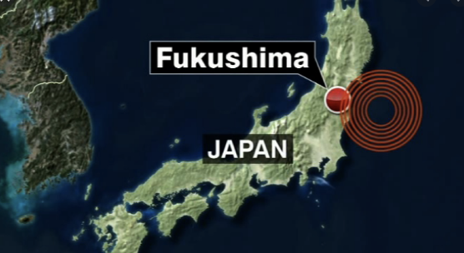
Dig deeper (optional)
Earthquake
1. Research what happened at the Fukushima nuclear plant after the tsunami that hit Japan in 2011.
2. Discuss the ethical implications of building nuclear power plants in an earthquake zone and potentially endangering lives.
https://www.bbc.co.uk/news/world-12783832

